Slide 1
Ashish Anil Waykar
Crekaa
Theme Selected : Employment

Slide 2
INSTRUCTIONS:
DELETE THIS SLIDE
For your hackathon presentation, please use these slides as a template.
You are encouraged to make adjustments as necessary to suit your requirements. These slides will provide a structured framework for presenting your research and analysis.
Consider how your insights contribute to creating a better world for everyone and sparking positive change. Use this as a focal point when presenting your analysis.
Note: You are instructed to use only the approved datasets (refer to Terms & Conditions). Participants failing to cite data sources from approved sources or using datasets outside of the approved list will not be considered.

Slide 3
Problem
Architecture Flow
Problem Statement:
Theme: Employeement
This track explores the multifaceted landscape of employment in India. Find methods to enhance job opportunities, bridge skill gaps, and empower individuals on their journey towards meaningful and sustainable employment in the country.
< Insert Snowflake Architecture Diagram >
My Project Deployement Is Pending I need some time to deploy this project on realtime server
Hypothesis
Technologies Used
National Development:
Sustainable employment contributes to the overall development of the nation. It can lead to poverty reduction, improved living standards, and increased social mobility. A focus on employment aligns with the broader goals of national development and prosperity.
Innovation and Competitiveness:
A workforce with diverse skills and talents fosters innovation and enhances a nation's competitiveness on the global stage. By addressing employment-related themes, India can position itself as a hub for innovation, attracting investments and opportunities.
<Add logos or names of languages / libraries / repositories / platforms used / cite data sources used>
Language : Python
Framework : Streamlit

Slide 4
Insight and Recommendations #1
Insight
Title of Insight
Skill Mismatch Analysis:
Conduct a detailed analysis of the skills demanded by the job market versus the skills possessed by the workforce. Identify areas where skill gaps exist and propose strategies for upskilling and reskilling programs.
Entrepreneurship and Small Businesses:
Explore the role of entrepreneurship and small businesses in job creation. Analyze the challenges faced by small enterprises and recommend policies to support their growth, thereby generating more employment opportunities.
3. Impact of Technology:
Investigate the impact of technology on employment patterns. Assess how automation, artificial intelligence, and other technological advancements are reshaping the job market and propose measures to mitigate potential job displacement.
< Insert Graph / Image / Video here >
Recommendation
Collaborative Research and Knowledge Sharing.
Investment in Sustainable Employment Practices.
Technology Adoption and Training.
Localized Skill Development Initiatives.

Slide 5
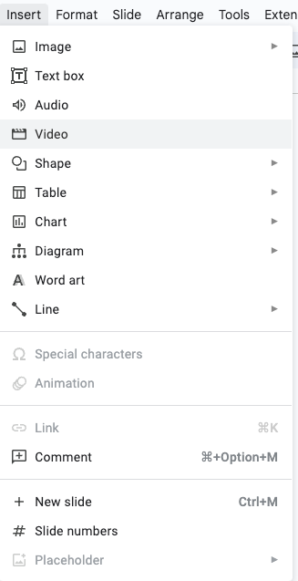
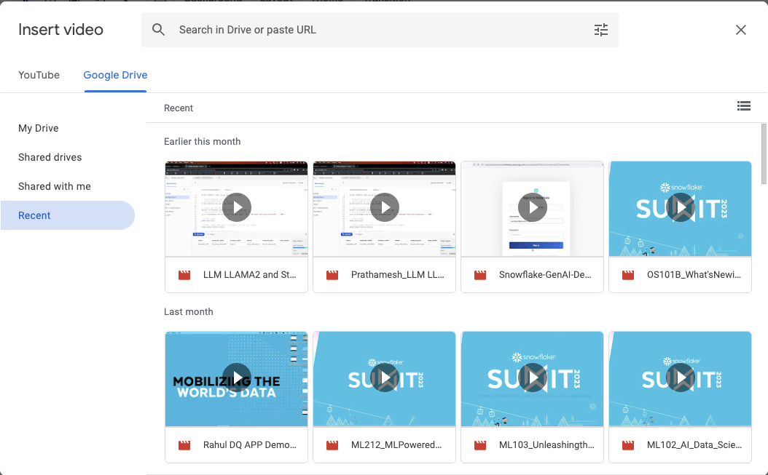
Embed Video walkthrough of code and app (max. 10 min.)
Notes:
Link to Video should be publicly available. Please adhere to the time limit.

Slide 6
THANK YOU

